Slide 1
The Case for Event-driven Architecture
Boulder .NET Meetup
May 2018
Robert Koch
Data Science & Cloud Architect
22 May 2018

Slide 2
Agenda
Show sample workflow
Presenting gaps to workflow
Resolving gaps the “old way”
Intro to Event-driven architecture (EDA)
Apply EDA to current workflow
Show benefits

Slide 3
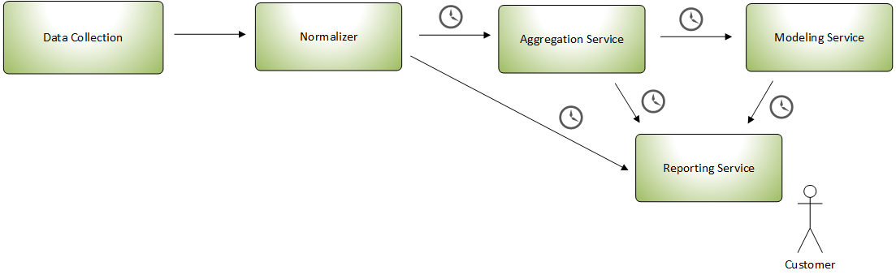
Current workflow
Walk-through…

Slide 4
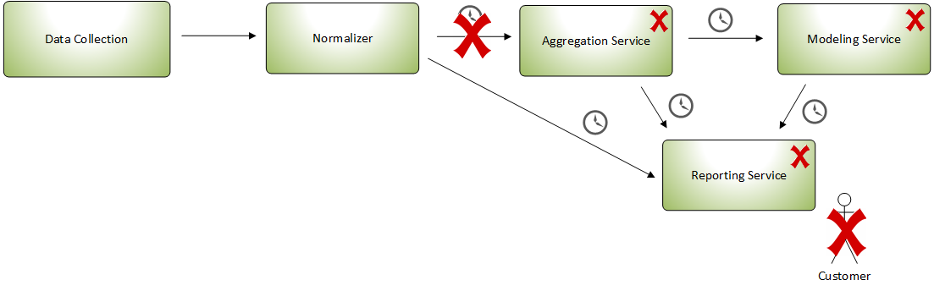
Magnifying the gaps
What ifs?

Slide 5
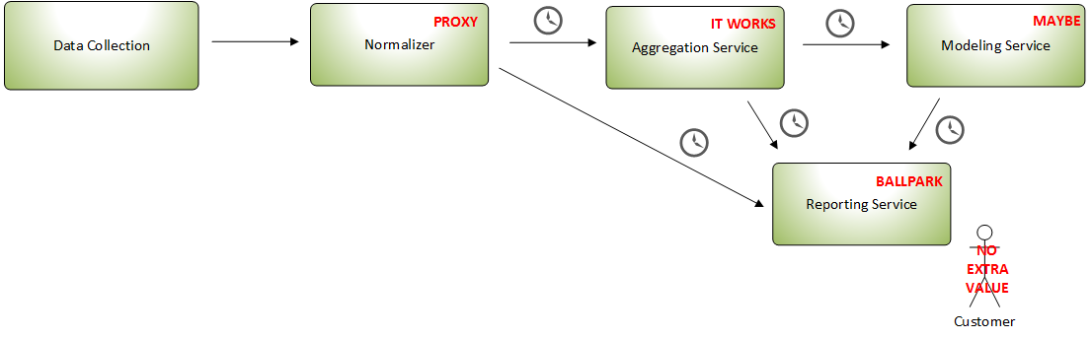
What can we do?
A workaround

Slide 6
Event-driven architecture keys
Moves data as fast as you want it to
React to business activity, AKA events
Simple, event streams, complex
Separation of concerns
Do away with data stores with event streams
Enhance SOA (command-and-control)
Multiple consumers!!

Slide 7
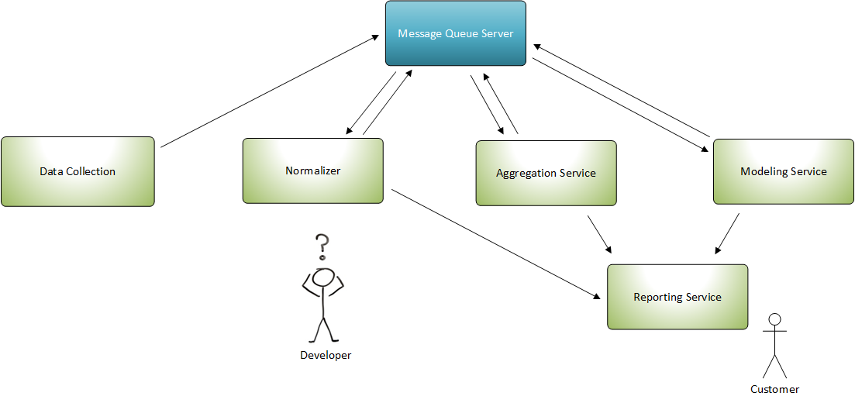
What about MQ?
Nice, but has drawbacks, let’s revisit workflow

Slide 8
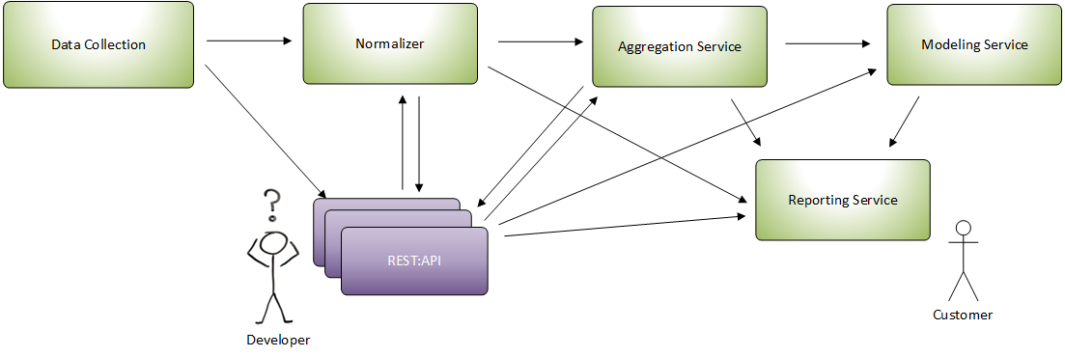
SOA Pattern
Works great with EDA; by itself, not the answer

Slide 9
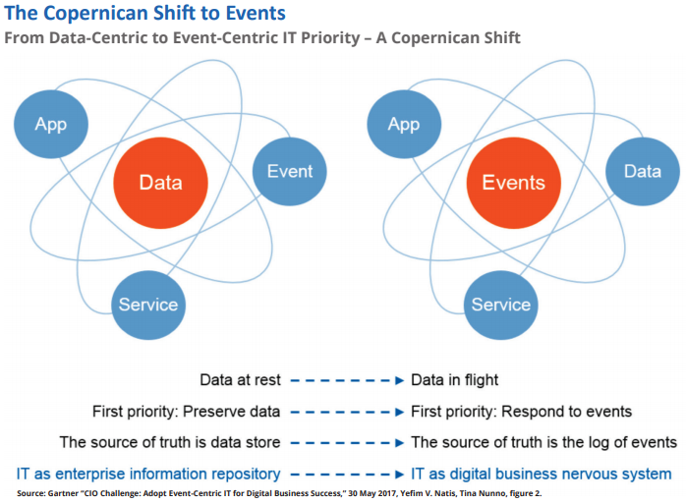
Rethinking your Universe

Slide 10
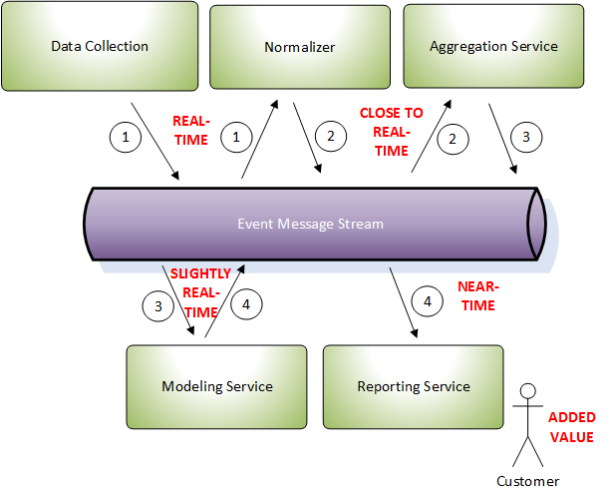
Event-driven architecture diagram
Cleaner
architecture

Slide 11
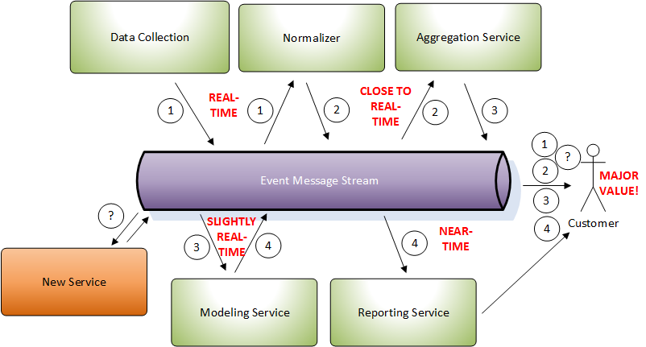
EDA with a new service added
Pluggable

Slide 12
Advantages of EDA
Taking the E and L out of ETL
Services doesn’t need knowledge of up or down stream systems
What orchestration? It’s all chorographical.
Scalable
Less coupling

Slide 13
Conclusion
Walk-through again as to why we have EDA
How does it benefit all involved?
Types of event-driven architecture
Simple
Event streams
Complex
Multiple consumers
Alternative to data stores

Slide 14
What tooling?
BPM Tools
Camunda
Alfresco
Existing database? use CDC/Connectors
Apache/Confluent Kafka
AWS Kinesis
Azure Event Hub/Event Service Bus

Slide 15
References
Thoughts on Service Oriented Architecture and Event-Driven Architecture, by Jack van Hoof https://soa-eda.blogspot.com/2006/11/how-eda-extends-soa-and-why-it-is.html
How to set your priorities with Business Architecture, presentation by Daniel Lambert https://www.slideshare.net/DanielLambert4/how-to-set-your-priorities-with-business-architecture-94473490
Serverless Architectures on AWS, by Peter Sbarski: ISBN 9781617293825
BPM Task, blog by Gary Samuelson http://garysamuelson.com/blog/?p=1413
Business Architecture and BPM Alignment, workshop by Lloyd Dugan and Neal McWhorter, Business Architecture Guild
Kafka Streams in Action, by Bill Bejeck, No ISBN yet, Manning Early Access Program
Event-driven architecture, (PDF) by Jonathan Schabowsky, a senior architect in Solace’s Office of the CTO
And of course the community with their assorted blogs, tweets, articles that might have influenced my thinking.

Slide 16
Contact
Email: rob.koch@live.com
Twitter: @robcube
Github: http://github.com/robcube
** You may find me at the nearest whiteboard **

